Slide 1
Customer Lifetime Value (I): Contractual Settings
Lecture 6
Customer Analytics

Slide 2
Agenda
Conceptual definition & applications
Primitives of CLV
Model 1: geometric model of retention
Model 2: shifted beta-geometric model of retention
Heterogeneity and increasing retention rates
Calculating CLV/RLV

Slide 3
Customer Lifetime Value
CLV is the present value of the future profits associated with a particular customer
Uncertain from today’s perspective—
it’s a forecast/prediction!
Revenues less costs of marketing, selling, production, servicing
Time value of money:
€1 today > €1 tomorrow
Measured for individual customers; recognize every customer is different

Slide 4
Uses of CLV
Tell you what each of your individual customers is worth (useful beyond other measures like NPS, clicks, etc)
Byproduct: you can use it to predict purchasing, benchmark with marketing efforts
Upper bound on spending for customer acquisition, retention, development
Value company: add up all customer’s CLV to measure customer equity (cf. brand equity)

Slide 5
Forming segments based on CLV
Create segments: separate most valuable customers from everyone else, focus efforts
Platinum (5% of customers): 50% of CLV
Gold (15%): 30% of CLV
Silver (30%): 20% of CLV
Lead (50%): 0% of CLV

Slide 6
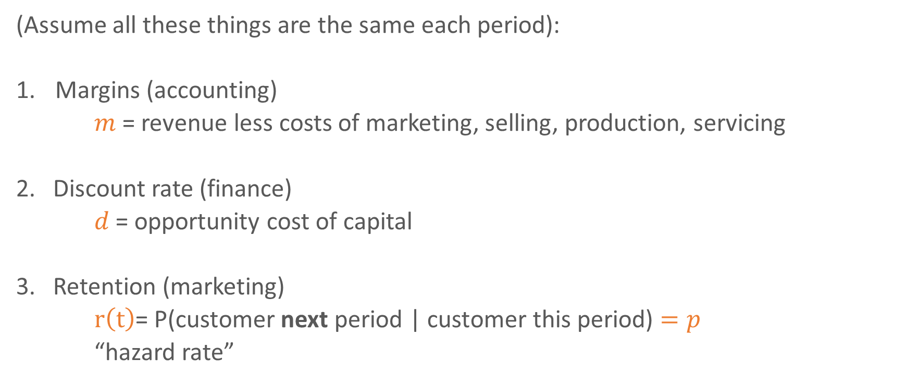
CLV primitives
(Assume all these things are the same each period):
Margins (accounting)
$m$ = revenue less costs of marketing, selling, production, servicing
2. Discount rate (finance)
$d$ = opportunity cost of capital
3. Retention (marketing)
$r\left(t\right)$= P(customer next period | customer this period) $=p$
“hazard rate”
Geometric model
Key source of uncertainty in CLV models: how long will customer remain?

Slide 7

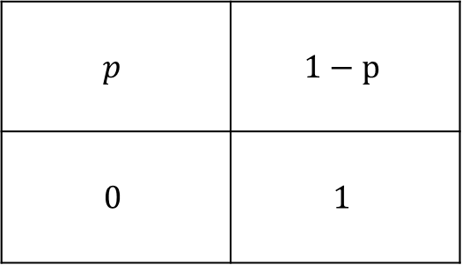



Retention as a two-state Markov chain
Next customer state
$$p$$
$$1−p$$
$$1$$
Retained
Churned
$$p$$ | $$1−p$$
$$0$$ | $$1$$
Retained
(customer)
Churned
(not customer)
Retained
Previous customer state
Churned
Random variable $T$ is the amount of time spent as customer (in retained state)
$$r\left(t\right)=P\left(T>t | T>t−1\right)=p$$
Geometric distribution that starts at 1. The survival function is the probability that a customer lasts longer than $t$
$$P\left(T>t\right)=S\left(t\right)=p^{t}$$
$$t=1,2,…$$

Slide 8

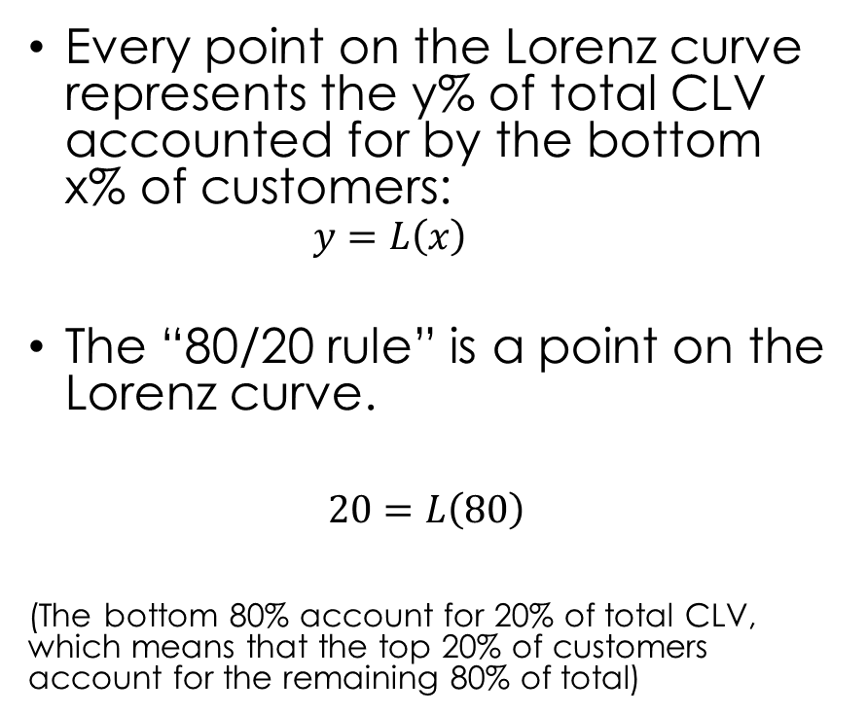

Survival function
Retention rate
$$S(t)=p^{t}$$
In general, retention & survival are related
0.80 prob. longer than 1 period
$$r\left(t\right)=\frac{S(t)}{S\left(t−1\right)}$$
0.64 prob. longer than 2 periods
$$S(t)=r\left(1\right)r\left(2\right)…r\left(t\right)$$
.07 prob longer than 12 periods

Slide 9




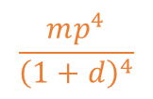




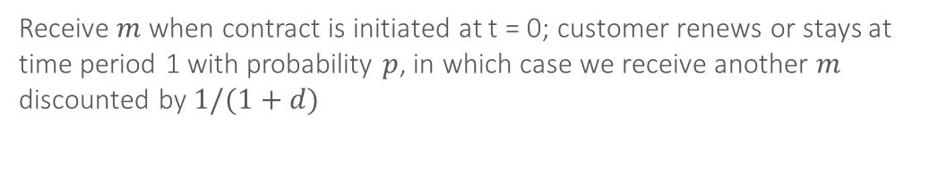
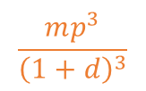









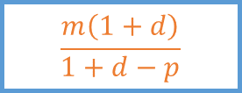
CLV traditional approach: the formula
E[CLV]=
$$m$$
+
$$\frac{mp}{1+d}$$
+
$$\frac{mp^{2}}{{\left(1+d\right)}^{2}}$$
+
$$\frac{mp^{3}}{{\left(1+d\right)}^{3}}$$
$$\frac{mp^{4}}{{\left(1+d\right)}^{4}}$$
$$\frac{m\left(1+d\right)}{1+d−p}$$
A x B x C
+
=
…
A
Discounted to Present
$$1/(1+d)$$
$$1/{\left(1+d\right)}^{2}$$
$$1/{\left(1+d\right)}^{3}$$
$$1/{\left(1+d\right)}^{4}$$
B
Prob. cust. survives past t: $S(t)$
$$p$$
$p^{2}$
$$p^{3}$$
$$p^{4}$$
C
Margin
$$m$$
$$m$$
$$m$$
$$m$$
$$m$$
…
3
Time (0 is present)
0
2
4
1
Receive $m$ when contract is initiated at t = 0; customer renews or stays at time period 1 with probability $p$, in which case we receive another $m$ discounted by $1/(1+d)$

Slide 10
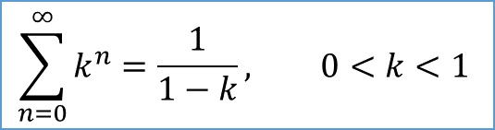
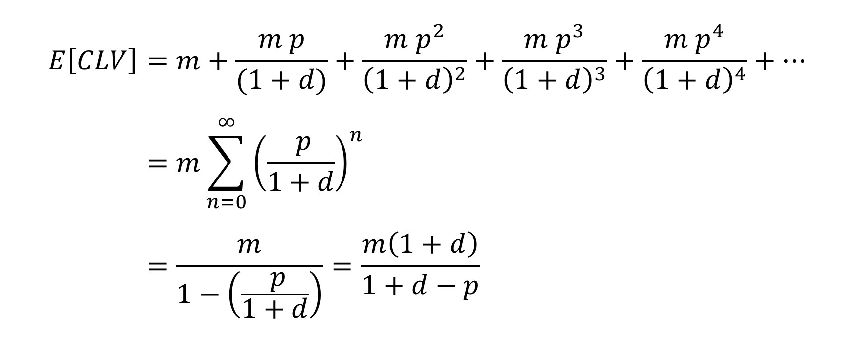
CLV calculations
$$E\left[CLV\right]=m+\frac{m p}{(1+d)}+\frac{m p^{2}}{{\left(1+d\right)}^{2}}+\frac{m p^{3}}{{\left(1+d\right)}^{3}}+\frac{m p^{4}}{{\left(1+d\right)}^{4}}+… \\ =m\sum_{n=0}^{∞}{{\left(\frac{ p}{1+d}\right)}^{n}} \\ =\frac{m}{1−\left(\frac{ p}{1+d}\right)}=\frac{m\left(1+d\right)}{1+d−p}$$
Geometric series
$$\sum_{n=0}^{∞}{k^{n}}=\frac{1}{1−k}, 0<k<1$$

Slide 11

Example: $m$= 100, $p$ = 0.80, $d$ = 0.10
E[CLV]=
100
+
72
+
53
+
38
+
28
…
=
367
$$m$$
+
$$\frac{mp}{1+d}$$
+
$$\frac{mp^{2}}{{\left(1+d\right)}^{2}}$$
+
$$\frac{mp^{3}}{{\left(1+d\right)}^{3}}$$
$$\frac{mp^{4}}{{\left(1+d\right)}^{4}}$$
$$\frac{m\left(1+d\right)}{1+d−p}$$
A x B x C
+
=
…
A
Discounted to Present
$$1/(1+d)$$
$$1/{\left(1+d\right)}^{2}$$
$$1/{\left(1+d\right)}^{3}$$
$$1/{\left(1+d\right)}^{4}$$
B
Prob. cust. survives past t: $S(t)$
$$p$$
$p^{2}$
$$p^{3}$$
$$p^{4}$$
C
Margin
$$m$$
$$m$$
$$m$$
$$m$$
$$m$$
…
3
Time (0 is present)
0
2
4
1
Expected customer lifetime value of this customer is €367

Slide 12

Sum of first 10 terms vs. infinite horizon formula
Example: $m$= 100, $p$ = 0.80, $d$ = 0.10
0 | 100
1 | 73
2 | 53
3 | 38
4 | 28
5 | 20
6 | 15
7 | 11
8 | 8
9 | 6
10 | 4
Each subsequent term is smaller
356 vs. 367 (from formula)

Slide 13
CLV vs. residual lifetime value (RLV)
CLV = for a not-yet-acquired customer, from first purchase
RLV = Residual Lifetime Value of already existing customer, including future purchases
E.g., what’s the value of a customer who with an “age” of 3 (3 years as a customer)?

Slide 14

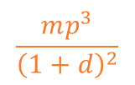


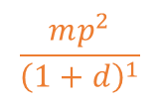

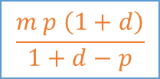
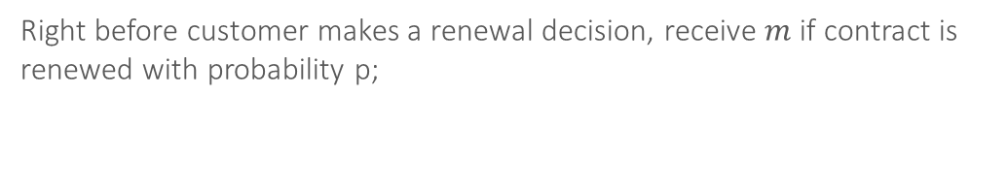

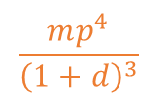

RLV: right before next renewal
$$mp$$
+
$$\frac{mp^{2}}{{\left(1+d\right)}^{1}}$$
+
$$\frac{mp^{3}}{{\left(1+d\right)}^{2}}$$
$$\frac{mp^{4}}{{\left(1+d\right)}^{3}}$$
$$\frac{m p \left(1+d\right)}{1+d−p}$$
A x B x C
+
=
…
present
A
Discounted to Present
$$1/{\left(1+d\right)}^{1}$$
$$1/{\left(1+d\right)}^{2}$$
$$1/{\left(1+d\right)}^{3}$$
B
Prob. cust. survives past t: $S(t)$
$$p$$
$p^{2}$
$$p^{3}$$
$$p^{4}$$
C
Margin
$$m$$
$$m$$
$$m$$
$$m$$
…
t+2
Time (t is present)
t-1
t+1
t+3
t*
history
future
Right before customer makes a renewal decision, receive $m$ if contract is renewed with probability p;

Slide 15



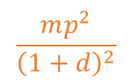


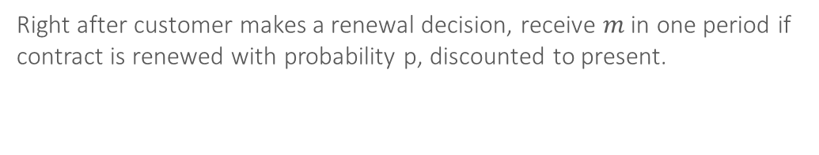



RLV: right after renewal
$$\frac{mp}{{\left(1+d\right)}^{1}}$$
+
$$\frac{mp^{2}}{{\left(1+d\right)}^{2}}$$
+
$$\frac{mp^{3}}{{\left(1+d\right)}^{3}}$$
$$\frac{mp^{4}}{{\left(1+d\right)}^{4}}$$
$$\frac{m p }{1+d−p}$$
A x B x C
+
=
…
present
A
Discounted to Present
$$1/{\left(1+d\right)}^{1}$$
$$1/{\left(1+d\right)}^{2}$$
$$1/{\left(1+d\right)}^{3}$$
$$1/{\left(1+d\right)}^{4}$$
B
Prob. cust. survives past t: $S(t)$
$$p$$
$p^{2}$
$$p^{3}$$
$$p^{4}$$
C
Margin
$$m$$
$$m$$
$$m$$
$$m$$
…
t+2
Time (t is present)
t-1
t+1
t+3
t*
history
future
Right after customer makes a renewal decision, receive $m$ in one period if contract is renewed with probability p, discounted to present.

Slide 16

Problem: retention rates increase
The geometric model is typically not a good description of reality
Why?
Retention rates are not constant: often increase the longer the customer has remained a customer (“customer age”)
Hence basing CLV & RLV calculations on constant retention will bias results
Typical real-world scenario
Geometric model
$$r\left(t\right)=p$$

Slide 17
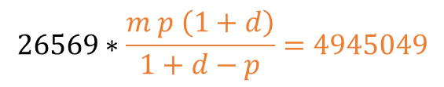

An example
RLV
Number of customers by year of acquisition
Standing at the end of 2018, what is the residual lifetime value of the 26569 customers remaining? Assume contracts last a year
Profit per year = 100
Discount rate = 10%
How do we measure retention probability?
Retention rate = ratio of the number of retained customers to the number at risk
2014 | 2015 | 2016 | 2017 | 2018
10000 | 6334 | 4367 | 3264 | 2604
 | 10000 | 6334 | 4367 | 3264
 |  | 10000 | 6334 | 4367
 |  |  | 10000 | 6334
 |  |  |  | 10000
10000 | 16334 | 20701 | 23965 | 26569
$$\overline{p}=\frac{2604+3264+4367+6334}{3264+4367+6334+10000}=0.691$$
plug into RLV formula
$$26569∗\frac{m p \left(1+d\right)}{1+d−p}=4945049$$

Slide 18





Issue #2: customer heterogeneity
Problem #1
Number of customers by year of acquisition
Each cohort has a different retention rate, with earlier cohorts having larger retention rate:
Customers who started in 2014
Customers who started in 2017
2014 | 2015 | 2016 | 2017 | 2018
10000 | 6334 | 4367 | 3264 | 2604
 | 10000 | 6334 | 4367 | 3264
 |  | 10000 | 6334 | 4367
 |  |  | 10000 | 6334
 |  |  |  | 10000
10000 | 16334 | 20701 | 23965 | 26569
Retention rate in 2018
$$p_{1}=\frac{2604}{3264}=0.798$$
$$p_{2}=\frac{3264}{4367}=0.747$$
$$p_{3}=\frac{4367}{6334}=0.689$$
$$p_{4}=\frac{6334}{10000}=0.633$$
$$\overline{p}=0.691$$
Fader and Hardie (2010), Customer Base Valuation in a Contractual Setting

Slide 19
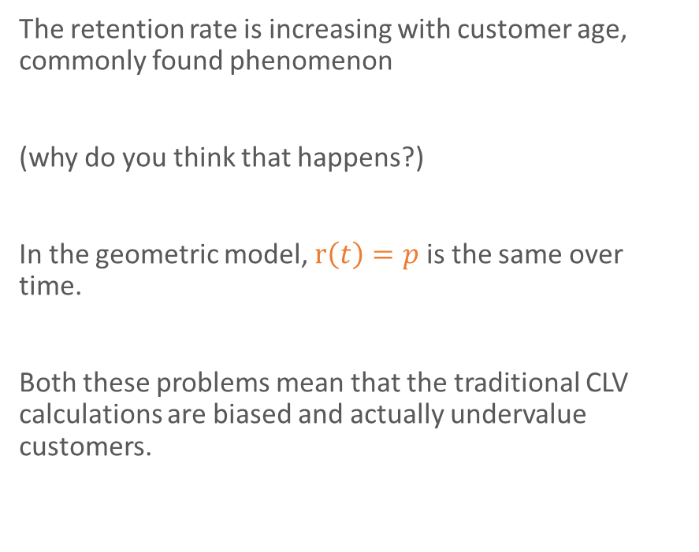
Issue #2: customer heterogeneity
Problem #2
Retention rate by year of acquisition
The retention rate is increasing with customer age, commonly found phenomenon
(why do you think that happens?)
In the geometric model, $r\left(t\right)=p$ is the same over time.
Both these problems mean that the traditional CLV calculations are biased and actually undervalue customers.
Fader and Hardie (2010), Customer Base Valuation in a Contractual Setting

Slide 20
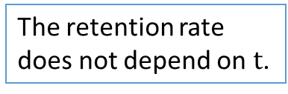
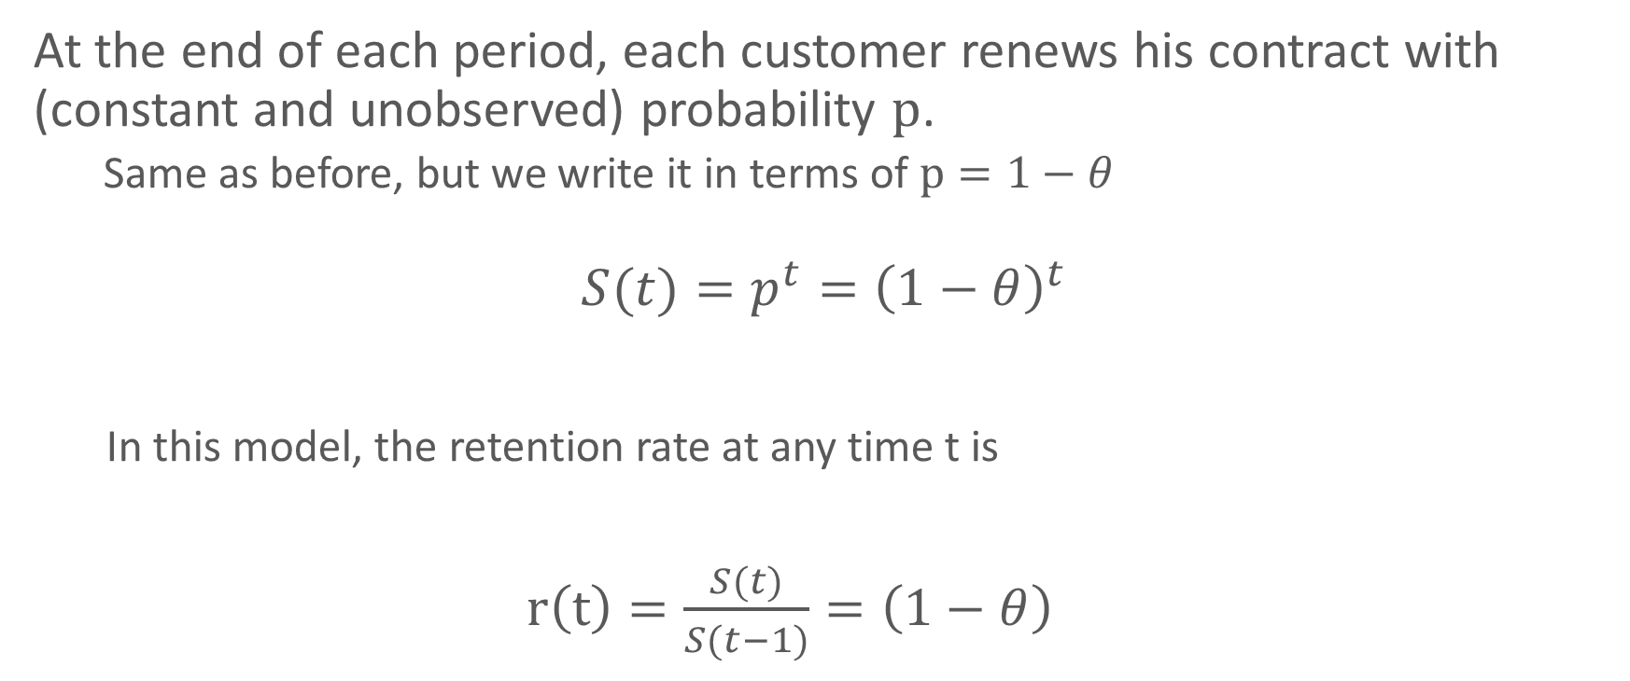
Review: geometric model
At the end of each period, each customer renews his contract with (constant and unobserved) probability $p$.
Same as before, but we write it in terms of $p=1−θ$
$$S(t)={p^{t}=\left(1−θ\right)}^{t}$$
In this model, the retention rate at any time t is
$r\left(t\right)=\frac{S(t)}{S(t−1)}=\left(1−θ\right)$
The retention rate does not depend on $t$.
Fader and Hardie (2007), How to Project Customer Retention

Slide 21
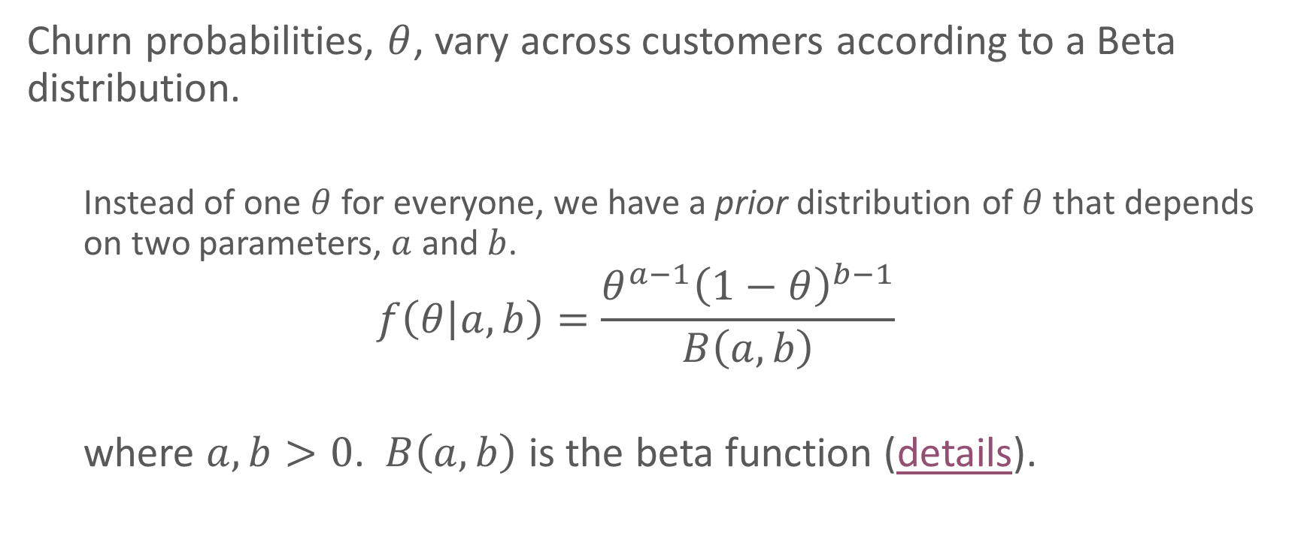
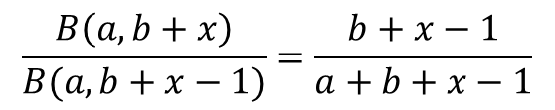
Prior distribution
Churn probabilities, $θ$, vary across customers according to a Beta distribution.
Instead of one $θ$ for everyone, we have a prior distribution of $θ$ that depends on two parameters, $a$ and $b$.
$$f\left(θ | a,b\right)=\frac{θ^{a−1}{\left(1−θ\right)}^{b−1}}{B\left(a,b\right)}$$
where $a,b>0$. $B\left(a,b\right)$ is the beta function (details).
We will use this formula later
$$\frac{B\left(a,b+x\right)}{B(a,b+x−1)}=\frac{b+x−1}{a+b+x−1}$$
Fader and Hardie (2007), How to Project Customer Retention

Slide 22

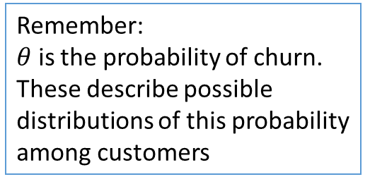



General shapes of the beta distribution
Spread out across whole range, but most likely to stay
$$b$$
Most customers fall within a certain range
Remember:
$θ$ is the probability of churn.
These describe possible distributions of this probability among customers
$$1$$
Two types of customers:
extremely likely & unlikely
Spread out across whole range, but most likely to churn
$$1$$
$$a$$
Fader and Hardie (2007), How to Project Customer Retention

Slide 23
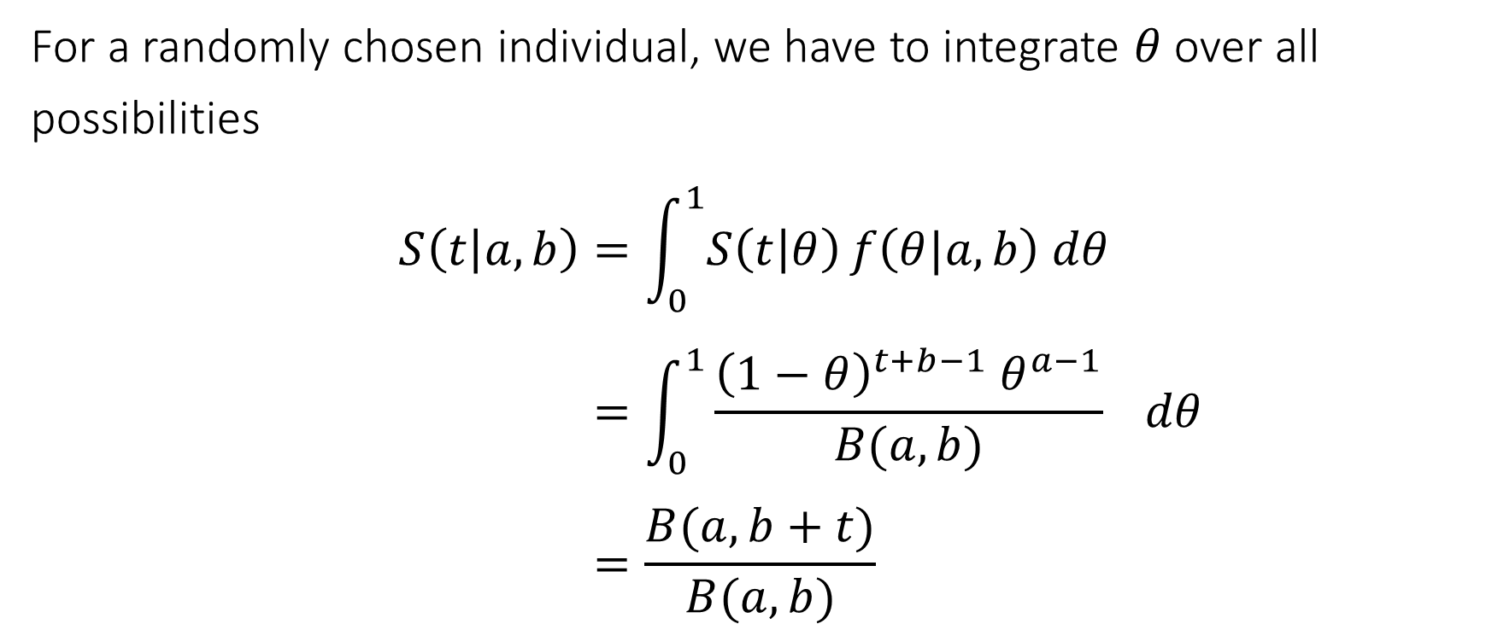
Shifted Beta-geometric model
For a randomly chosen individual, we have to integrate $θ$over all possibilities
$$S\left(t | a,b\right)=\int_{0}^{1}{S\left(t | θ\right)}f\left(θ|a,b\right) dθ \\ =\int_{0}^{1}{\frac{{\left(1−θ\right)}^{t+b−1} θ^{a−1}}{B(a,b)} } dθ \\ =\frac{B(a,b+t)}{B(a,b)}$$
Shifted geo. dist.
Beta dist.

Slide 24

Retention rate in shifted beta-geometric model
$$r\left(t\right)=\frac{S(t)}{S(t−1)} \\ =\frac{B(a,b+t)/B(a,b)}{B(a,b+t−1)/B(a,b)} \\ =\frac{b+t−1}{a+b+t−1}$$
Does retention increase with t?
How fast?

Slide 25
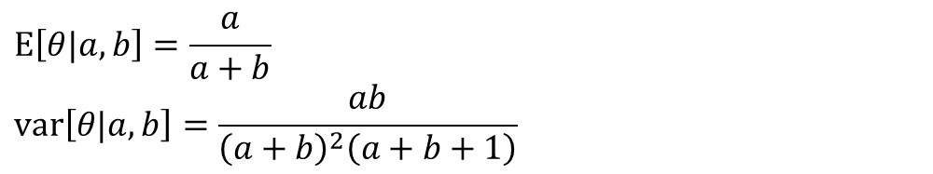


Two different groups
Two populations with the same mean, but different variance
$$a=2.0, b=8.0$$
$$a=0.1, b=0.4$$
Beta distribution
$$\text{E}\left[θ|a,b\right]=\frac{a}{a+b}$$
$$\text{var}\left[θ|a,b\right]=\frac{ab}{{\left(a+b\right)}^{2}\left(a+b+1\right)}$$
https://en.wikipedia.org/wiki/Beta_distribution
Notes:
var = .0145 if a=2,b=8
Var = .1067 if a = .1, b=.4

Slide 26
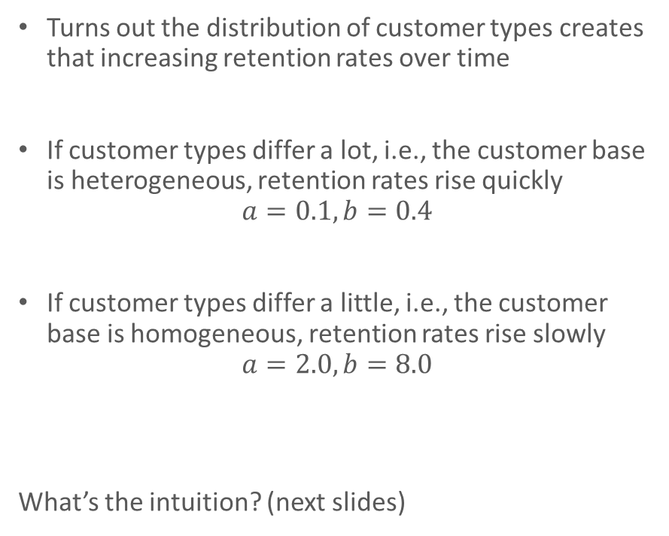
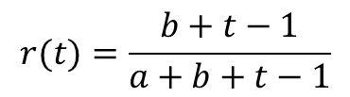


Implications for retention rate
Customer heterogeneity
Retention rate dynamics
Turns out the distribution of customer types creates that increasing retention rates over time
If customer types differ a lot, i.e., the customer base is heterogeneous, retention rates rise quickly
$$a=0.1, b=0.4$$
If customer types differ a little, i.e., the customer base is homogeneous, retention rates rise slowly
$$a=2.0, b=8.0$$
What’s the intuition? (next slides)
$$r(t)=\frac{b+t−1}{a+b+t−1}$$
$$a=0.1, b=0.4$$
$$a=2.0, b=8.0$$

Slide 27

1000 customers acquired
$$S(0)=1.000$$
1000 draws from a Beta distribution where $a=2, b=8$

Slide 28
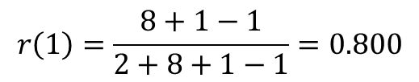

Period 1
Expect 200 to quit, leaving 800
$$r\left(1\right)=\frac{8+1−1}{2+8+1−1}=0.800$$
$$S\left(1\right)=0.800×1.000$$
Where does this distribution come from? (next slide)

Slide 29


Bayes Rule: updating the distribution of $θ$
$$P\left(B | A\right)=\frac{P\left(A | B\right)P\left(B\right)}{P(A)} \\ f\left(θ | T>t\right)=\frac{S\left(t | θ\right)f\left(θ | a,b\right)}{\int{S\left(t | θ\right)f\left(θ | a,b\right) dθ}} \\ =\frac{{\left(1−θ\right)}^{t+b−1}θ^{a−1}/B(a,b)}{B(a,b+t)/B(a,b)} \\ =\frac{{θ^{a−1}\left(1−θ\right)}^{t+b−1}}{B(a,b+t)}$$
This is just a beta distribution with $a^{∗}=a$ and $b^{∗}=b+t$

Slide 30
Period 1
Expect 200 to quit, leaving 800
$$r\left(1\right)=\frac{8+1−1}{2+8+1−1}=0.800$$
$$S\left(1\right)=0.800×1.000$$
800 draws from a Beta distribution where $a^{∗}=2, b^{∗}=b+1=9$

Slide 31
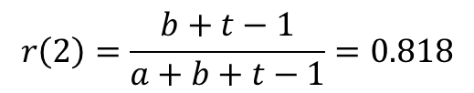

Period 2
Expect 145 to quit, leaving 655
$$r\left(2\right)=\frac{b+t−1}{a+b+t−1}=0.818$$
$$S\left(2\right)=0.818×0.800 =0.655$$
655 draws from a Beta distribution where $a^{∗}=2, b^{∗}=b+2=10$

Slide 32
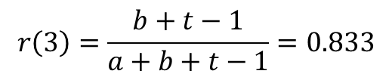
Period 3
Expect 110 to quit, leaving 545
$$r\left(3\right)=\frac{b+t−1}{a+b+t−1}=0.833$$
$$S\left(3\right)=0.833×0.818×0.800 =0.545$$
545 draws from a Beta distribution where $a^{∗}=2, b^{∗}=b+3=10$

Slide 33

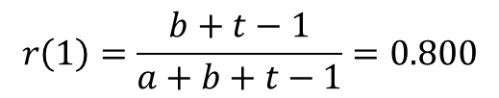
Compare to more heterogeneous customer base, period 1
cut off, max=568
$$a=0.1, b=0.4$$
Model parameters for high heterogeneity
$$r\left(1\right)=\frac{b+t−1}{a+b+t−1}=0.800$$
800 draws from a Beta distribution where $a^{∗}=0.1, b^{∗}=0.1+1=1.1$

Slide 34
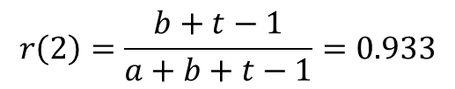
period 2
cut off, max=567
$$r\left(2\right)=\frac{b+t−1}{a+b+t−1}=0.933$$
747 draws from a Beta distribution where $a^{∗}=0.1, b^{∗}=0.1+2=2.1$

Slide 35
Concepts
Customer heterogeneity
Retention rate dynamics
Retention rates slope upward even if customers propensity to churn stays the same over time.
Why?
High-churn customers drop out early
Sorting effect in a heterogeneous population
Remaining customers have lower churn probabilities
Happens more quickly the more heterogeneity there is
Ignoring this will bias your CLV estimates downwards

Slide 36
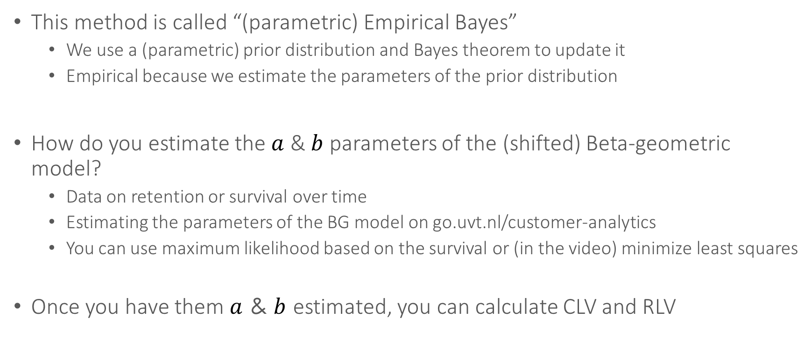
Estimation
This method is called “(parametric) Empirical Bayes”
We use a (parametric) prior distribution and Bayes theorem to update it
Empirical because we estimate the parameters of the prior distribution
How do you estimate the $a$ & $b$ parameters of the (shifted) Beta-geometric model?
Data on retention or survival over time
Estimating the parameters of the BG model on go.uvt.nl/customer-analytics
You can use maximum likelihood based on the survival or (in the video) minimize least squares
Once you have them $a$ & $b$ estimated, you can calculate CLV and RLV

Slide 37
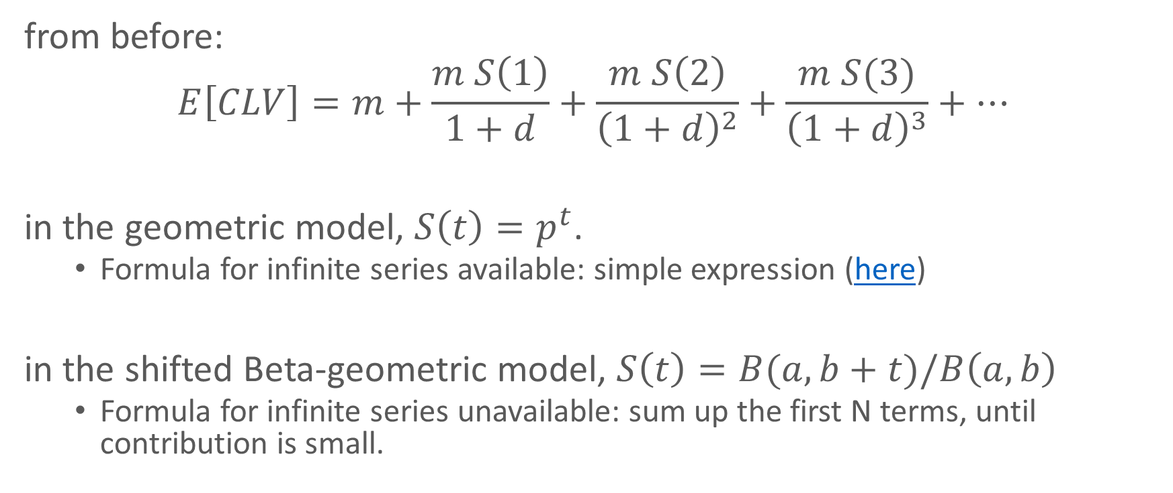
CLV with the BG model
from before:
$$E\left[CLV\right]=m+\frac{m S\left(1\right)}{1+d}+\frac{m S\left(2\right)}{{\left(1+d\right)}^{2}}+\frac{m S(3)}{{\left(1+d\right)}^{3}}+…$$
in the geometric model, $S\left(t\right)=p^{t}$.
Formula for infinite series available: simple expression (here)
in the shifted Beta-geometric model, $S\left(t\right)=B(a,b+t)/B\left(a,b\right)$
Formula for infinite series unavailable: sum up the first N terms, until contribution is small.

Slide 38
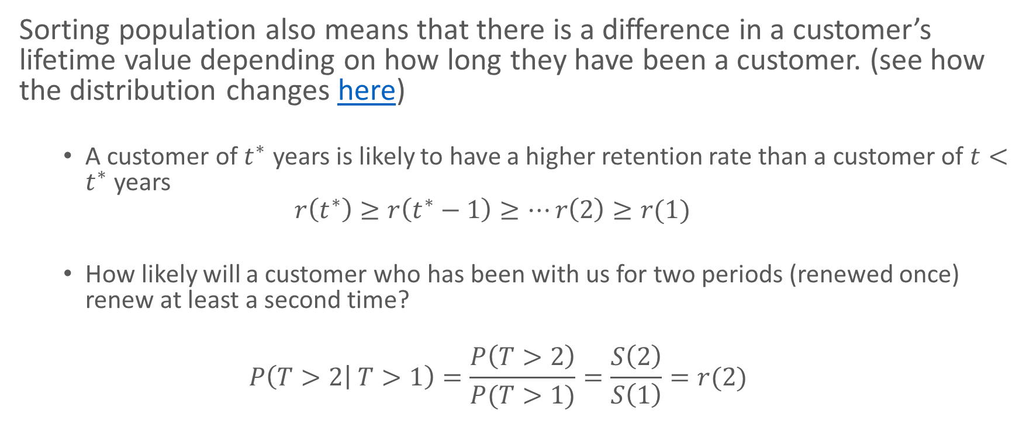
RLV under the BG model
Sorting population also means that there is a difference in a customer’s lifetime value depending on how long they have been a customer. (see how the distribution changes here)
A customer of $t^{∗}$ years is likely to have a higher retention rate than a customer of $t<t^{∗}$ years
$$r\left(t^{∗}\right)≥r\left(t^{∗}−1\right)≥…r\left(2\right)≥r(1)$$
How likely will a customer who has been with us for two periods (renewed once) renew at least a second time?
$$P\left(T>2 | T>1\right)=\frac{P\left(T>2\right)}{P(T>1)}=\frac{S\left(2\right)}{S\left(1\right)}=r(2)$$

Slide 39
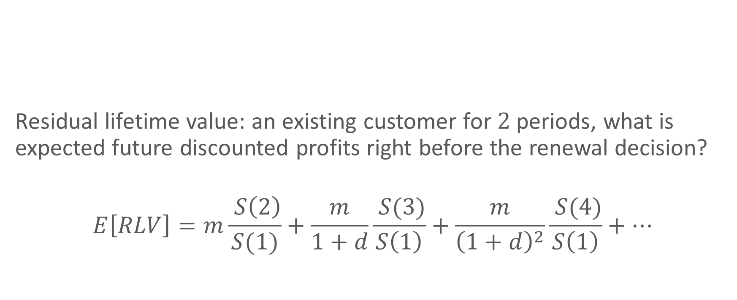
Residual lifetime value
Residual lifetime value: an existing customer for $2$ periods, what is expected future discounted profits right before the renewal decision?
$$E\left[RLV\right]=m\frac{ S\left(2\right)}{S(1)}+\frac{m}{1+d}\frac{ S(3)}{S\left(1\right)}+\frac{m}{{\left(1+d\right)}^{2}}\frac{ S(4)}{S\left(1\right)}+…$$
3
0
2
1
How do you create a spreadsheet to calculate CLV/RLV?
CLV & RLV with BG video

Slide 40
Customer Lifetime Value
Future value of your customers
Individual level
Incorporate customer heterogeneity in the model
Retention rate increases

Slide 41
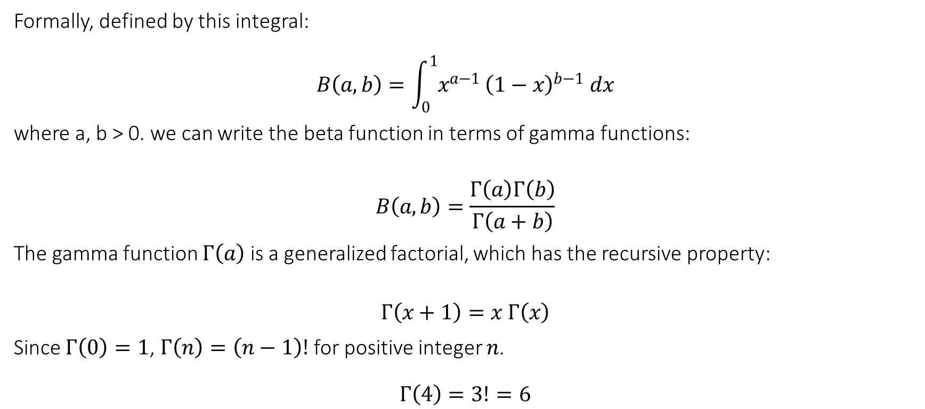
Aside: beta function
Formally, defined by this integral:
$$B\left(a,b\right)=\int_{0}^{1}{x^{a−1}}{\left(1−x\right)}^{b−1} dx$$
where a, b > 0. we can write the beta function in terms of gamma functions:
$$B\left(a,b\right)=\frac{Γ\left(a\right)Γ\left(b\right)}{Γ\left(a+b\right)}$$
The gamma function $Γ\left(a\right)$ is a generalized factorial, which has the recursive property:
$$Γ\left(x+1\right)=x Γ\left(x\right)$$
Since $Γ\left(0\right)=1$, $Γ\left(n\right)=\left(n−1\right)!$ for positive integer $n$.
$$Γ\left(4\right)=3!=6$$

